Slide 1
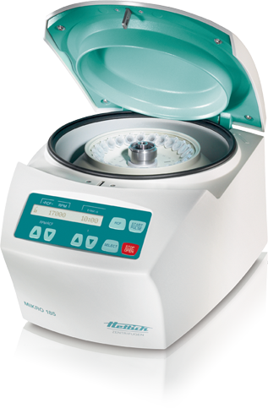
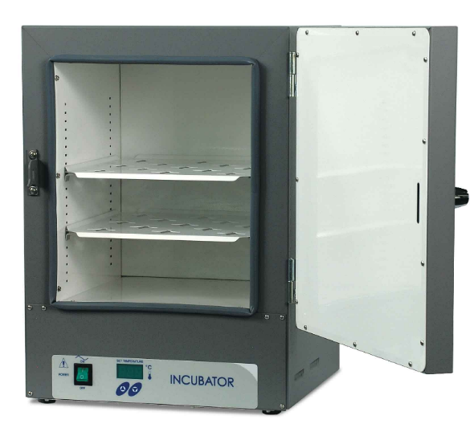
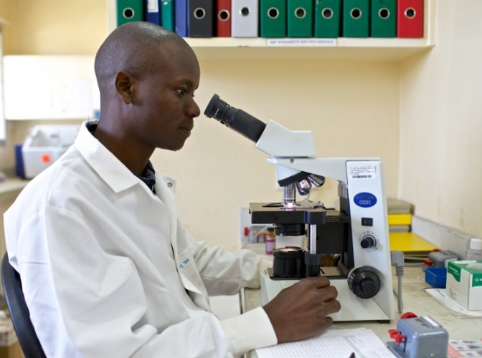
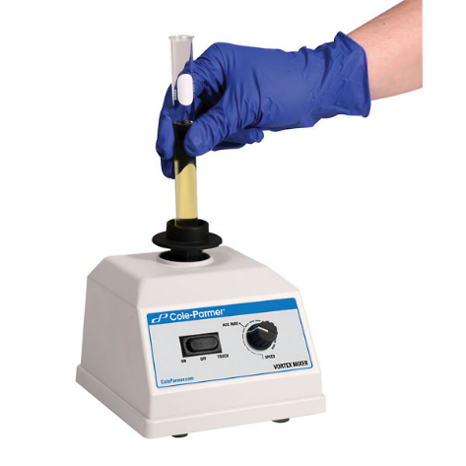
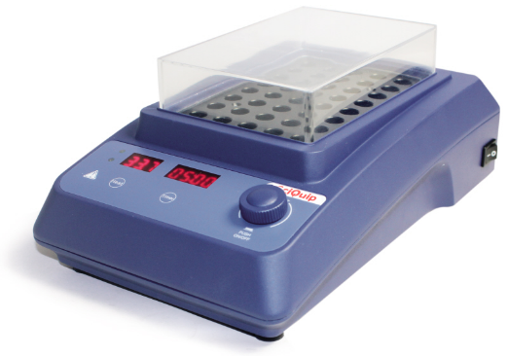
General Lab Instruments
principles of operation
construction
troubleshooting
preventive maintenance
performance monitoring
18.7.13 Maintain a vortex mixer, roller, water bath and block heater
18.7.12 Maintain centrifuges and incubators
18.7.2 Maintain microscopes
Unit C18.7 Maintaining Laboratory Equipment
Module 279 19 C Medical Instrumentation II
©
dr. Chris R. Mol, BME, NORTEC, 2016

Slide 2
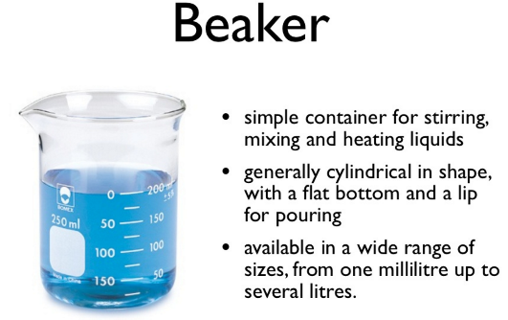
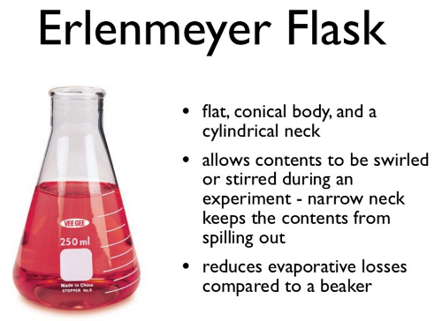
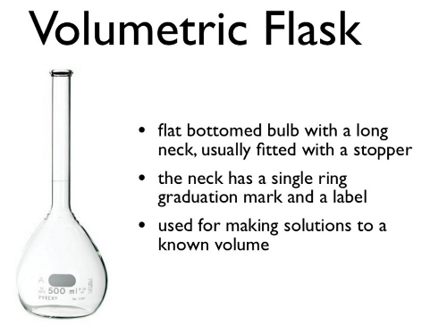
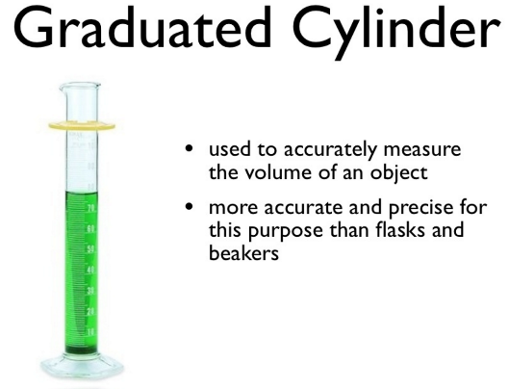
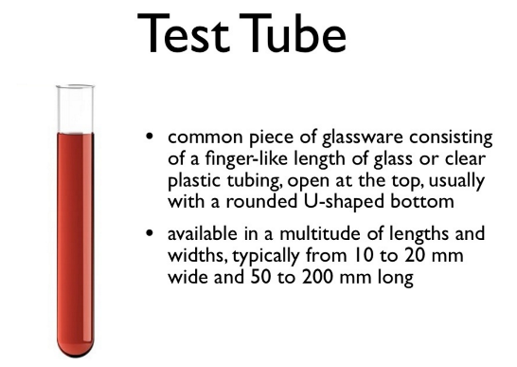
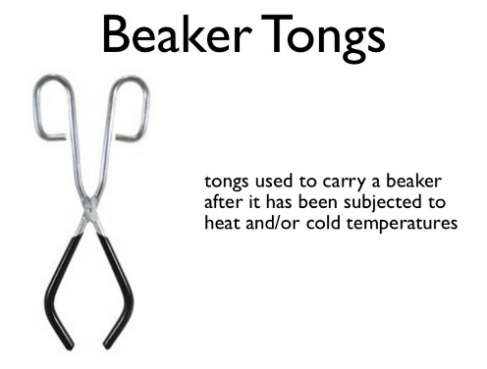
Standard Lab ‘Instruments’
©
General Lab Instruments
dr. Chris R. Mol, BME, NORTEC, 2016

Slide 3
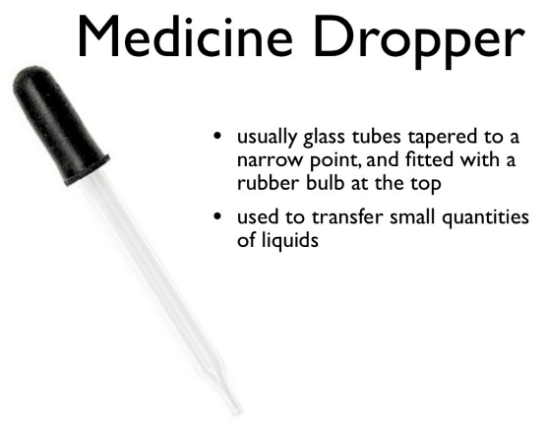
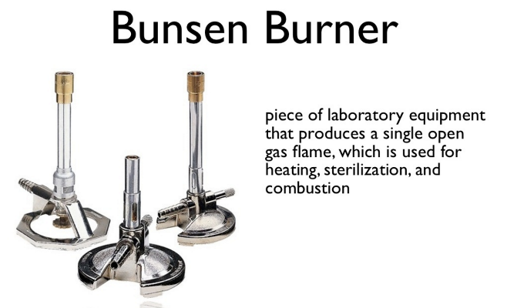
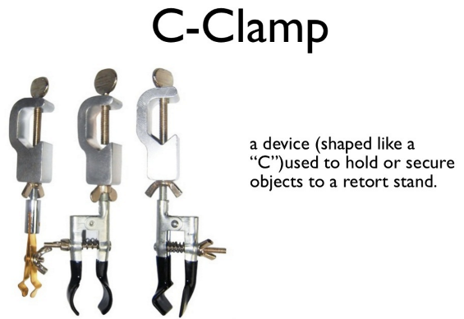
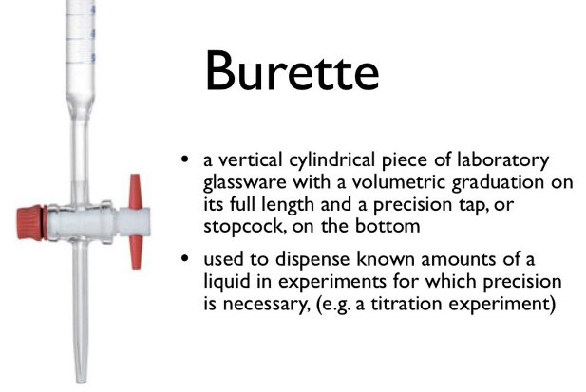
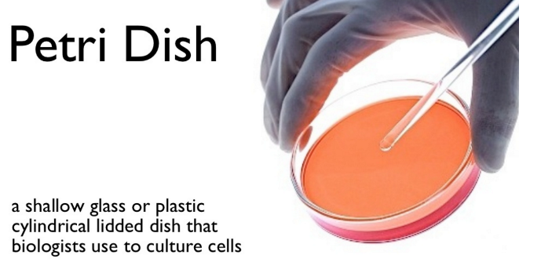
Standard Lab ‘Instruments’
©
General Lab Instruments
dr. Chris R. Mol, BME, NORTEC, 2016

Slide 4
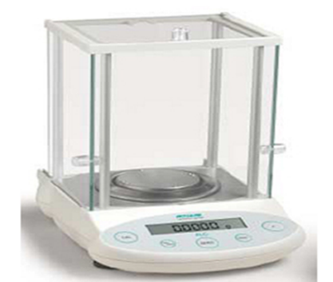
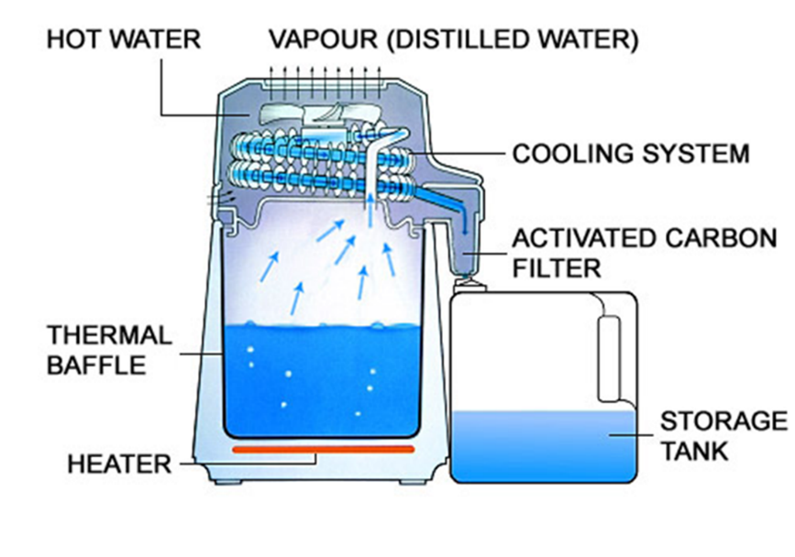
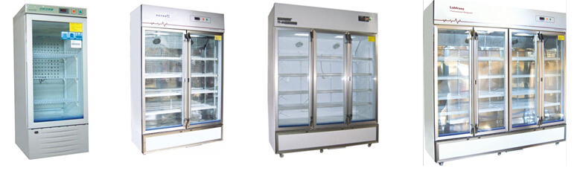
Standard Lab ‘Equipment’
Previously discussed standard lab equipment:
  (analytical) balances
  water distiller
  refrigerators
In these Lab lectures we will deal with:
  microscopes
  centrifuges
  incubators
  mixers
  rollers
  water baths
  block heaters
©
General Lab Instruments
dr. Chris R. Mol, BME, NORTEC, 2016

Slide 5


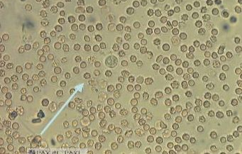
Microscope: Use
The optical (or ‘light’) microscope is a precision instrument with uses visible light and a system of lenses to magnify images of small tissue samples – up to 1000x magnification - so that these can be studied in detail.
The microscope is an important diagnostic aid in healthcare. It is used to examine body fluids, body tissues, and faeces throughout the clinical lab:
In hematology, microscopic analysis of blood cells helps diagnose blood disorders, as well as infections and allergies.
In histology, microscopic examinations can detect abnormal changes in tissues to differentiate benign, inflammatory, precancerous, or malignant conditions.
In biochemistry, microscopic examination of urinary sediment is extremely valuable in laboratory evaluation of kidney function;
In order to increase visibility of details, ‘staining’ or ‘colouring’ techniques (adding specific staining materials) are usually applied to the tissue samples before viewing.
©
General Lab Instruments
dr. Chris R. Mol, BME, NORTEC, 2016

Slide 6
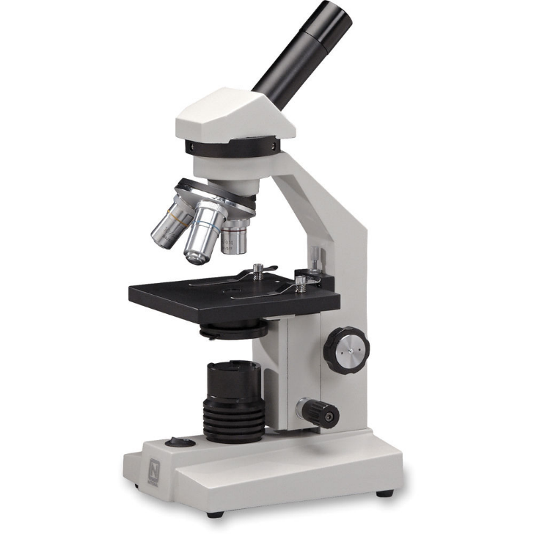
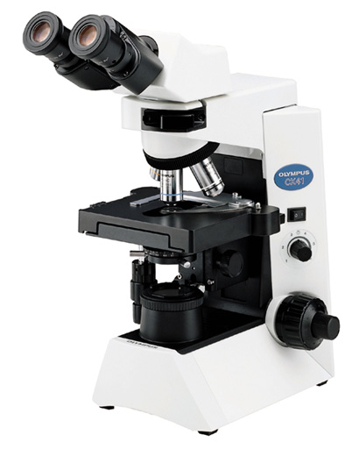
Microscope: models
A binocular microscope refers to any microscope with two eyepieces. High power microscopes typically have two eyepieces which view images through a single high-power objective lens. The image presented to each eye is exactly the same: a flat, 2-dimensional 'mono' image.
Monocular microscopes have a single eyepiece (ocular), showing a mono-image to one eye only.
©
General Lab Instruments
dr. Chris R. Mol, BME, NORTEC, 2016

Slide 7
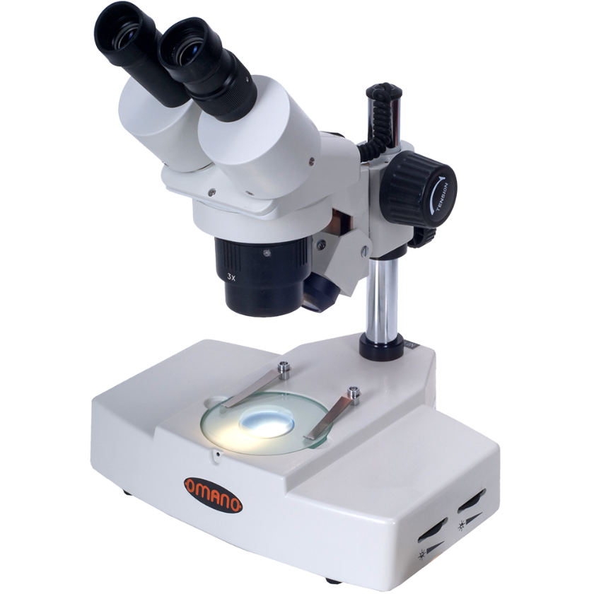
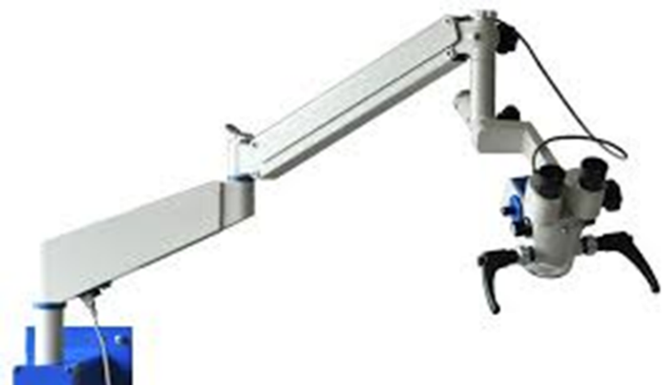
Stereo Microscope
A stereo microscope or dissecting microscope is designed for low magnification, typically using light reflected from the surface of an object rather than transmitted through it. The instrument uses two separate optical paths with two objectives and eyepieces to provide slightly different viewing angles to the left and right eyes. This arrangement produces a three-dimensional (stereo) visualization of the sample being examined.
The stereo microscope is often used to study the surfaces of solid specimens or to carry out close work such as dissection and micro-surgery (see ‘Operating Microscope’ in Medical Instrumentation I.
operating microscope
stereo microscope
©
General Lab Instruments
dr. Chris R. Mol, BME, NORTEC, 2016

Slide 8

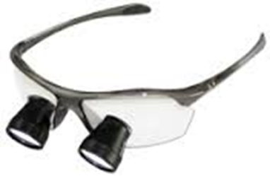
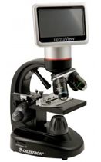
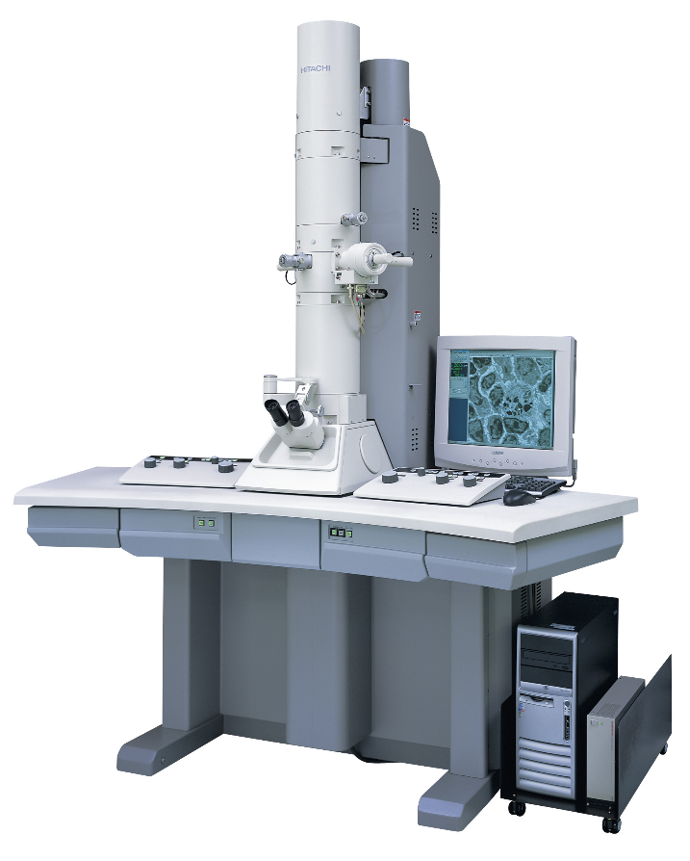
Microscope: models
A simple ‘microscope’ uses only one lens for magnification. It is found in simple magnification devices, such as the magnifying glass, and the loupe.
Digital microscope
with a display
An electron microscope uses a beam of accelerated electrons as a source of illumination. It can achieve magnifications of up to 10,000,000x
©
General Lab Instruments
dr. Chris R. Mol, BME, NORTEC, 2016

Slide 9
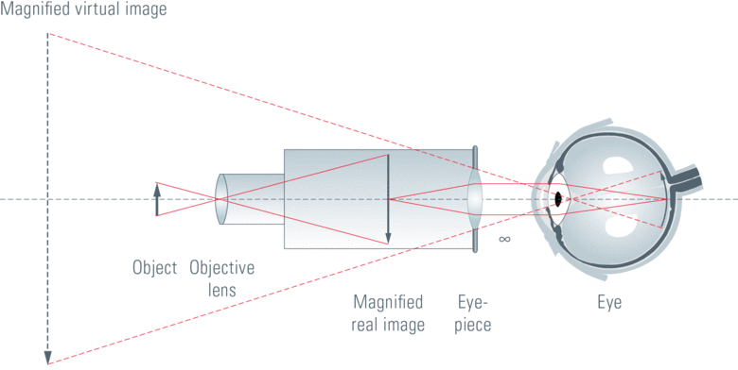
Microscope: Magnification
Optical magnification is the process to enlarge something in appearance. The degree of magnification is given by the magnification factor. Optical magnification is the ratio between the apparent size of an object (‘its size in an image’) and its true size, and thus it is a dimensionless number.
The optical microscope magnifies an object in two steps. The objective lens produces a magnified, real image of the object and the eye piece projects this image into the observer’s eye.
The magnification (M) is determined by the strength of eye piece and the objective lens, which is usually written on it.
For a microscope, M is calculated as
M _{microscope} = M _{objective} x M _{eyepiece}
General Lab Instruments
dr. Chris R. Mol, BME, NORTEC, 2016

Slide 10
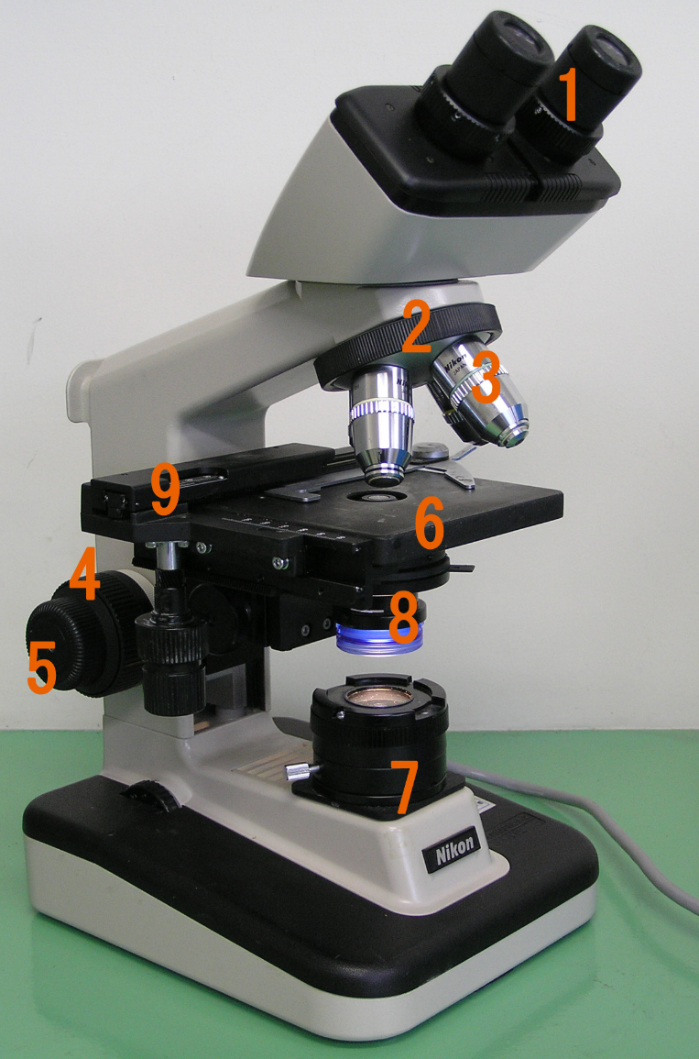
Microscope: Construction
ocular lens, or eyepiece
  A cylinder containing two or more lenses to bring the image to focus for the eye. Eyepieces are interchangeable and have different degrees of magnification, typically 2x, 5x and 10x.
2. objective turret
  A cylinder containing one or more lenses to collect light from the sample.
3. objective lenses
  At the lower end of the turret objective lenses are screwed into a circular nose piece which may be rotated to select the required objective lens. Typical magnification values of objective lenses are from 4x to 100x.
4. coarse adjustment knob and 5. fine adjustment knob to focus the image
6. object holder or stage
7. mirror or light
  sample illumination is controlled either via a mirror or via a controllable light source that is focused through an optical device called a
8. condenser with diaphragms and filters to process the light so that it becomes
homogeneous.
General Lab Instruments
dr. Chris R. Mol, BME, NORTEC, 2016

Slide 11
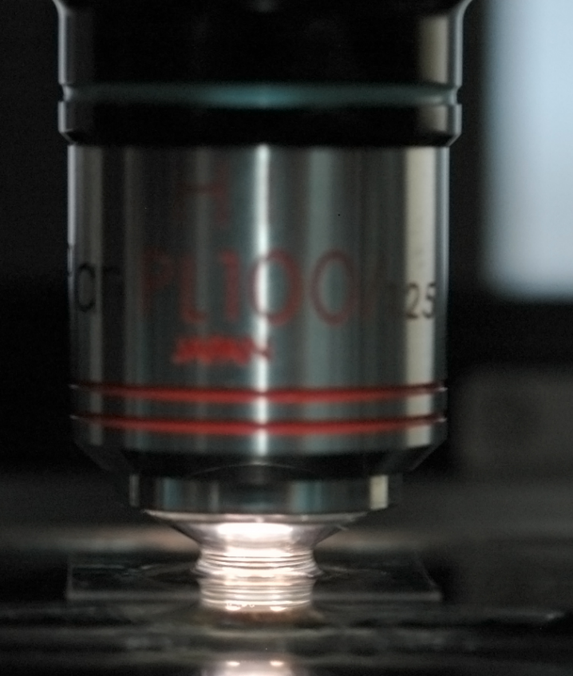

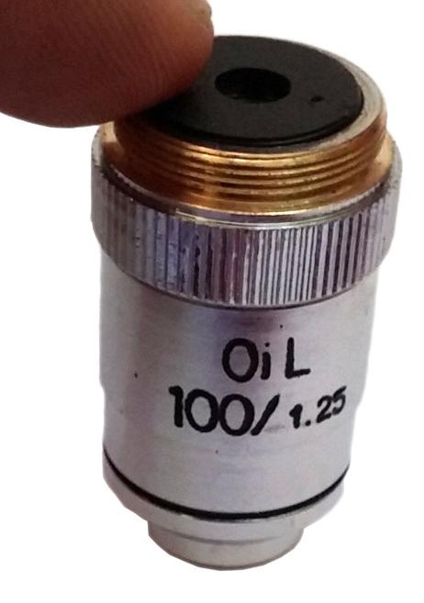
Oil Immersion Objectives
In light microscopy, oil immersion is a technique used to increase the resolving power of a microscope. This is achieved by immersing both the objective lens and the specimen in a transparent oil of high refractive index. A drop of oil is placed on top of the cover glass or specimen. After focusing the specimen under a low-power objective, the oil-immersion lens is moved into place. It contacts the oil and can touch the cover glass.
Immersion oils are transparent oils that have specific optical and viscosity characteristics.
oil-immersion lens
General Lab Instruments
dr. Chris R. Mol, BME, NORTEC, 2016

Slide 12
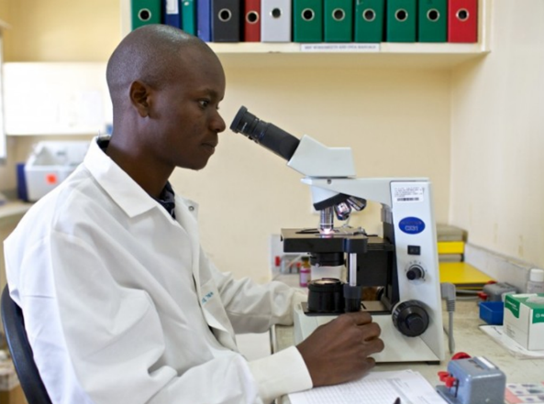
Microscope: Maintenance
User Maintenance: Cleaning and Storing
When the microscope is not in use, it should be kept covered with a clean cloth or plastic cover to protect the lenses from settling dust. Overnight it should be placed inside its box, with the door tightly closed. When it is warm and humid, the microscope should be stored in dry conditions when not in use: in a ‘warm cupboard’, with two or more, constantly burning 25-watt bulbs. The temperature inside the cupboard should be a constant 30–35 °C, with low humidity or in a continuously air-conditioned room.
Preventive Maintenance, every six months
  Clean with air brush or blower; no use of alcohol
  Lubricate adjustments
  Check function: lighting, image quality, knobs, ..
Corrective Maintenance
Usual problem is image quality (unclear images):
  check power, lighting (replace fuse, bulb)
  check cleanliness objective lens (clean)
  mechanical movement of adjustment knobs
When there is a need to dismount the different components of a microscope,
the main issue is to work very clean. Keep in mind that this is a precision instrument where everything should precisely fit together. Minimize application of force.
General Lab Instruments
dr. Chris R. Mol, BME, NORTEC, 2016

Slide 13
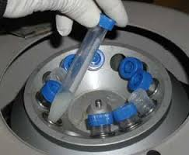


Laboratory centrifuges: principle and use
A laboratory centrifuge is driven by a motor and spins around liquid samples in test tubes at high speed.
It is used to separate substances of greater and lesser density in the test tube fluids such as blood and urine.
Through rapid rotation, a centrifugal force (directed away from the center of rotation) is generated. This causes heavier particles in the test tubes to move furthest away from the center of rotation (to the bottom of the test tube).
In a centrifuge, the tubes will point outward, so that the heavy parts are forced to the bottom of the tubes.
Centrifugation will separate blood in its heavier (erythrocytes) and lighter (plasma) elements.
©
General Lab Instruments
dr. Chris R. Mol, BME, NORTEC, 2016

Slide 14
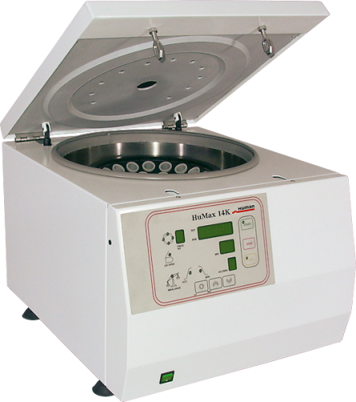
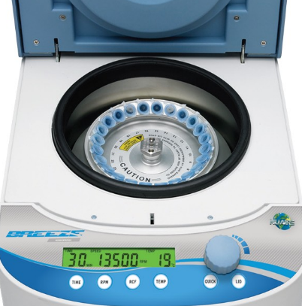
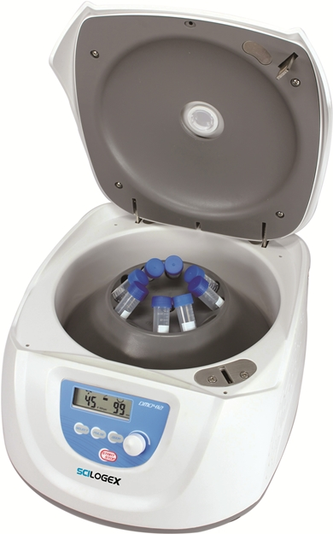
Centrifuge Models
There are different types of laboratory centrifuges such as:
Micro-centrifuges for small ‘micro-’tubes (up to 2 ml)
Clinical centrifuges for clinical applications like blood collection tubes, low-speed devices
Multipurpose benchtop centrifuges for a broad range of tube sizes, high variability
Micro centrifuge
Multipurpose benchtop centrifuge
Large lab centrifuge
Centrifuges may have a refrigeration function to prevent the temperature of sensitive samples to go up through the heat that is generated by the rapid spinning.
Clinical centrifuge
©
General Lab Instruments
dr. Chris R. Mol, BME, NORTEC, 2016

Slide 15
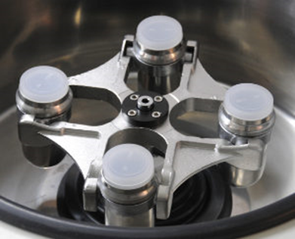
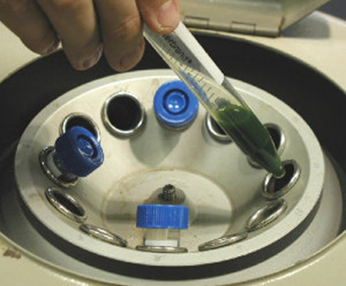
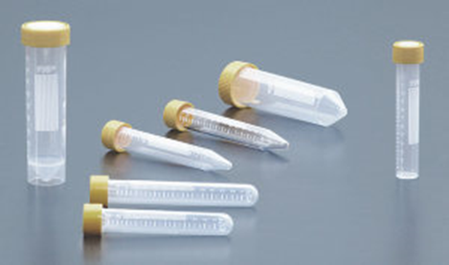
Centrifuges: Components
The centrifuge consists of a motor, a holder for the tubes which is called the rotor and some control electronics.
The rotor is connected directly to the motor shaft. There is no gear or other mechanics in between. A timer switches off the centrifuge automatically after some minutes.
Centrifuges include a speed control and a lid lock, which prevents the lid from opening while the rotor is spinning.
Swing out rotor
for low speed applications
Fixed angle rotor
for general purpose centrifuges: faster and less expensive
Tubes come in various sizes
©
General Lab Instruments
dr. Chris R. Mol, BME, NORTEC, 2016

Slide 16
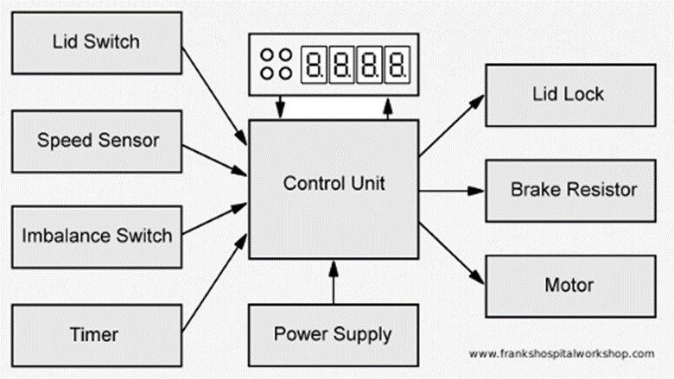
Centrifuges: Control unit
The control unit checks on all (safety) sensors and switches the centrifuge off in case of danger.
©
General Lab Instruments
dr. Chris R. Mol, BME, NORTEC, 2016

Slide 17
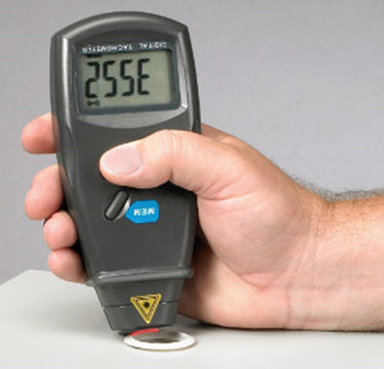
Centrifuges: Preventive Maintenance
Preventive maintenance to be done every 6 months, including the usual actions:
Cleaning (if necessary, when the user are not doing this frequently, as they should be trained to do) inside outside. Note that disinfection – and working with gloves – may be necessary.
Outside & Inside visual check: check on tight fixing of centre nut. Check for corrosion, printed circuit boards, ….
Lubrication: grease to joints and bearings (no oil!)
Seals and Gaskets: replace/repair if worn
Electric safety inspection and tests
Functional tests
  check speed, timer (with tachometer)
  verify lid security switch, alarms
  temperature (in case of refrigeration)
The majority of all centrifuge accidents results from user error: overfilling, unbalanced filling, ….
A tachometer is an optical measurement equipment. It needs to 'see' the rotating object
©
General Lab Instruments
dr. Chris R. Mol, BME, NORTEC, 2016

Slide 18
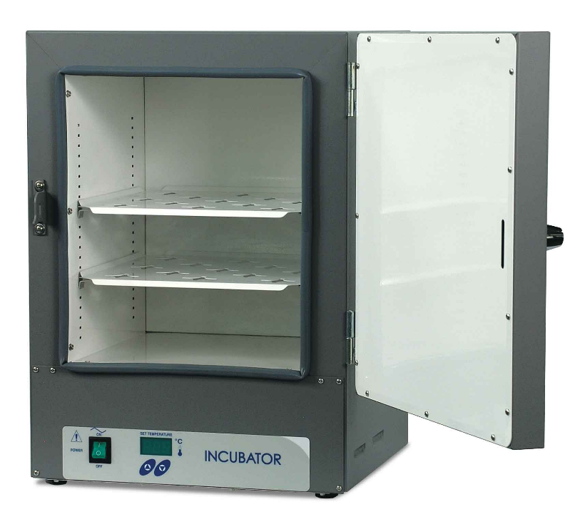
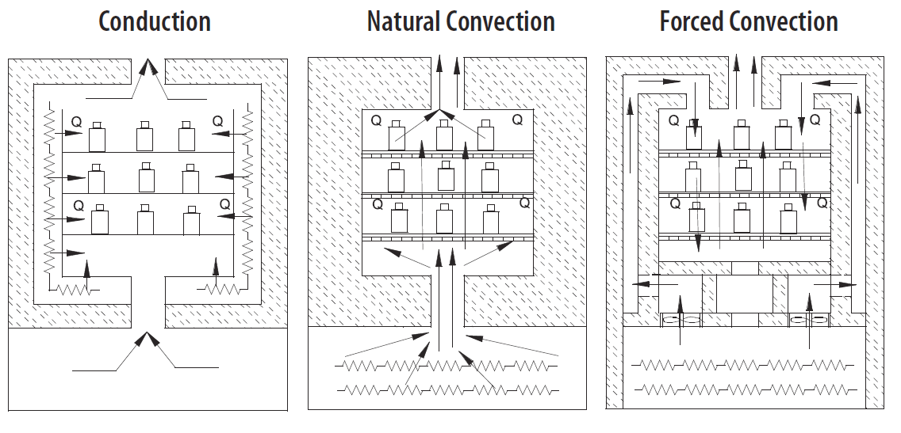
Incubators (‘brood stoves’)
The incubator is a chamber of controlled temperature, atmosphere and humidity to maintain live organisms - such as bacteriological, viral, cellular cultures - in an environment suitable for their growth.
Some Incubators only control temperature (10 °C and go up to 75 °C) while others control the atmospheric composition (incl. CO2) as well. Some include refrigeration systems.
incubator
Heat transfer systems used in incubators
©
General Lab Instruments
dr. Chris R. Mol, BME, NORTEC, 2016

Slide 19
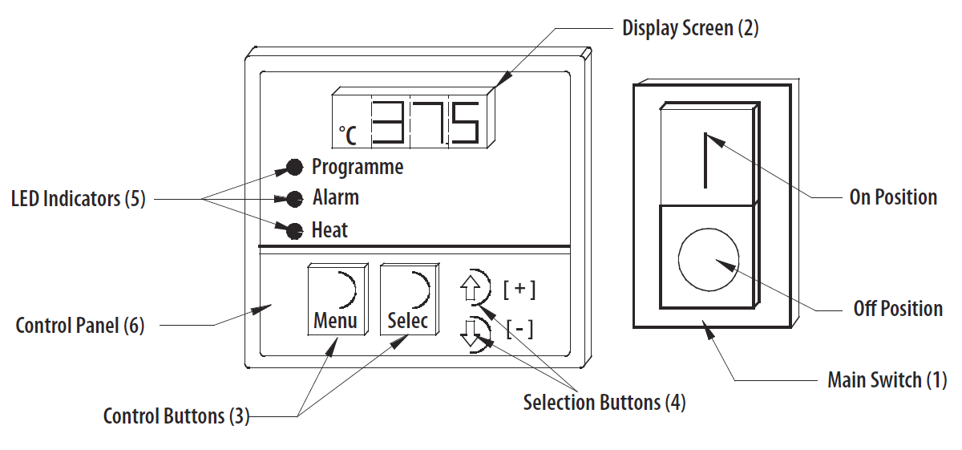
Incubator Components
Heating elements (system of resistors), generally located in the lower part of the incubator.
Cooling ventilator for internal circulation of air
Electronic control
Thermocouples
Glass door (internal) with handle.
Body of the incubator
Alarm temperatures can be set to trigger an alarm when the temperature goes out of range (max and min).
Free space on the sides and back of the incubator is required to allow a passage for cables and ventilation (5-10 cm).
Incubator Controls
©
General Lab Instruments
dr. Chris R. Mol, BME, NORTEC, 2016

Slide 20

Vortex Mixer
A vortex is a whirling mass of fluid or air, especially a whirlpool or whirlwind.
A vortex mixer is a simple device used commonly in laboratories to mix small tubes of liquid.
It consists of an electric motor with the drive shaft oriented vertically and attached to a cupped rubber piece mounted slightly off-center. As the motor runs the rubber piece oscillates rapidly in a circular motion. When a test tube or other appropriate container is pressed into the rubber cup the motion is transmitted to the liquid inside and a vortex is created.
Most vortex mixers have variable speed settings and can be set to run continuously, or to run only when downward pressure is applied to the rubber piece.
cupped rubber piece
In cell culture and microbiology laboratories vortex mixers may be used to suspend cells. In a biochemical or analytical laboratory they may be used to mix the reagents of an assay.
vortex mixer with speed control knob
©
General Lab Instruments
dr. Chris R. Mol, BME, NORTEC, 2016

Slide 21
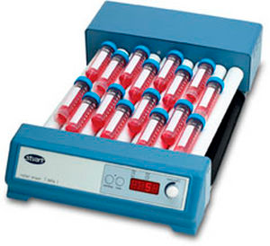
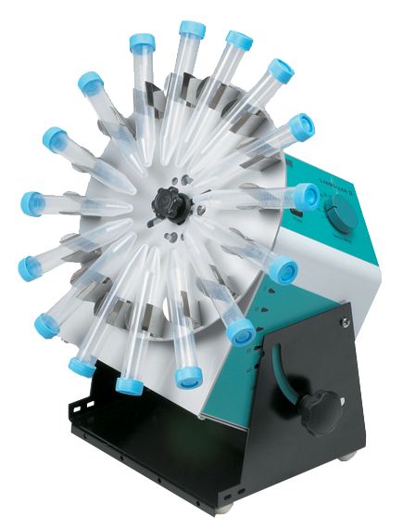
Roller (mixer)
A roller mixer is a device to mix fluids in test tubes. It may have the capacity to tilt as well. Speed, tilt and duration may be set by the user.
Used for e.g. blood samples. Gently rolling and tilting action prevents the sediment of the specimen and provides a homogenous specimen quality.
Plastic rollers are suitable for use with a variety of tubes.
rotator mixer
roller mixer
©
General Lab Instruments
dr. Chris R. Mol, BME, NORTEC, 2016

Slide 22
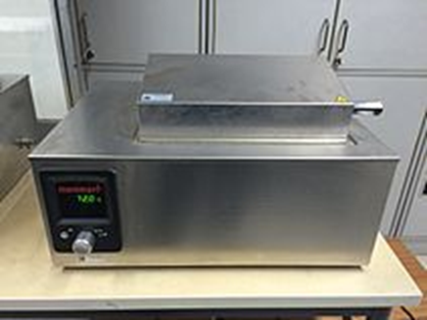
Water bath
A water bath is a container filled with heated water.
It is used to incubate samples in water at a constant temperature over a long period of time.
The users can set the bath to a desired temperature, up to 99.9 °C.
It is used for:
  warming of reagents,
  melting of substrates or
  incubation of cell cultures
  to enable certain chemical reactions to occur at high temperature.
Water bath is a preferred heat source for heating flammable chemicals instead of an open flame to prevent ignition.
When temperatures above 100 °C are required, alternative methods such as oil bath, silicone bath or sand bath can be used
water bath
©
General Lab Instruments
dr. Chris R. Mol, BME, NORTEC, 2016

Slide 23
Water bath: precautions
Do not heat a bath fluid above its flash point.
Water level should be regularly monitored, and filled with distilled water only. This is required to prevent salts from depositing on the heater.
Disinfectants can be added to prevent growth of organisms.
Raise the temperature to 90 °C or higher once a week for half an hour for the purpose of decontamination.
The cover is closed to prevent evaporation and to help reaching high temperatures.
Set up on a steady surface away from flammable materials.
©
General Lab Instruments
dr. Chris R. Mol, BME, NORTEC, 2016

Slide 24
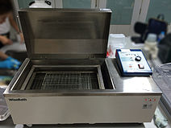
Types of water bath
Circulating water baths
are ideal for applications when temperature uniformity and consistency are critical. Water is thoroughly circulated throughout the bath resulting in a more uniform temperature.
Non-Circulating Water Baths
This type of water bath relies primarily on convection instead of water being uniformly heated. Therefore, it is less accurate in terms of temperature control.
Shaking Water Baths
This type of water bath has extra control for shaking, which moves liquids around. This shaking feature can be turned on or off. In microbiological practices, constant shaking allows liquid-grown cell cultures grown to constantly mix with the air.
shaking water bath
see video
©
General Lab Instruments
dr. Chris R. Mol, BME, NORTEC, 2016

Slide 25

Dry Block Heater
A (warming or dry) block heater is a device to heat up laboratory test tubes to a user defined temperature.
  different models with warming e.g. up to 100, 130 or 200 ⁰C
  with internal temperature sensor
  accuracy may be 0.1 – 1.0 ⁰C
  with timer
  with overheat protection
  mostly made from aluminum or steel block
  different models accommodate different numbers of test tubes
©
General Lab Instruments
dr. Chris R. Mol, BME, NORTEC, 2016

Slide 26

END
The creation of this presentation was supported by a grant from THET:
see https://www.thet.org/

